Slide 1

Pharmaceutical Management System
National institute of technology, jalandhar

Slide 2




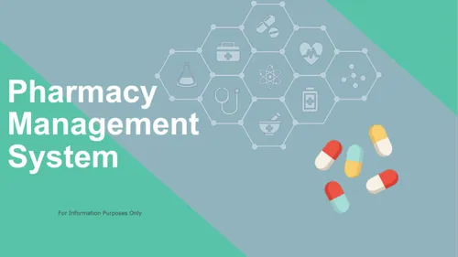




Pharmaceutical Management System
OOP
AIRLINE TICKET BOOKING
CG Pharmaceutical Management System

Slide 3







Pharmaceutical Management System
GROUP MEMBERS :
DISADVANTAGE
PERKENALAN
CHANDAN KUMAR 21103040
GURPARTAP SINGH 21103053
SUBMITTED TO : Mr. Rahul Aggarwal
ISLAM HADHARI
GROUP MEMBERS
CONCLUSION
KELUAR

Slide 4
Pharmaceutical Management System
PROJECT BACKGROUND
Project is basically based on online Pharmaceutical Management System . CG Pharmaceutical solve theproblem and reducing or possibly avoiding the contact of health care workers with infected people or patients. This program helps users in diagnose their health issue with the chatBot and fetch solution from the medical experts.

Slide 5
Pharmaceutical Management System
FUNCTIONS USED
OBJECTIVES
• To provide a contactless self-checkout facility for customers (patients).
• To help customers to diagnose their health issue with the ChatBot by answering a few basic questions.
• To reduce the contact of medical store workers with the patients during pandemic.
• Hassel free self-check-out system for users.
• Easy and effortless buying of health care products

Slide 6
Pharmaceutical Management System
FUNCTIONS USED
OOPS CONCEPTS USED
• Class and Objects
• Friend and Inline Functions
• Constructor and Destructor
• Inheritance
• Files

Slide 7
Pharmaceutical Management System
Use of various concepts
class person
class item
class admin
friend void update(item x[],int j,int y);
friend void adminupdate(item x[],int j,int y);
string iname;
string mail,ph;
float bill=0;
class customer
class cart
void customer ::buy(item o[])
void displaybill(cart d[],int m,float bill)
int choice,opt,sel,k=0,u,count;
void chatbot()
These are some of the classes friend function inheritance function string etc

Slide 8
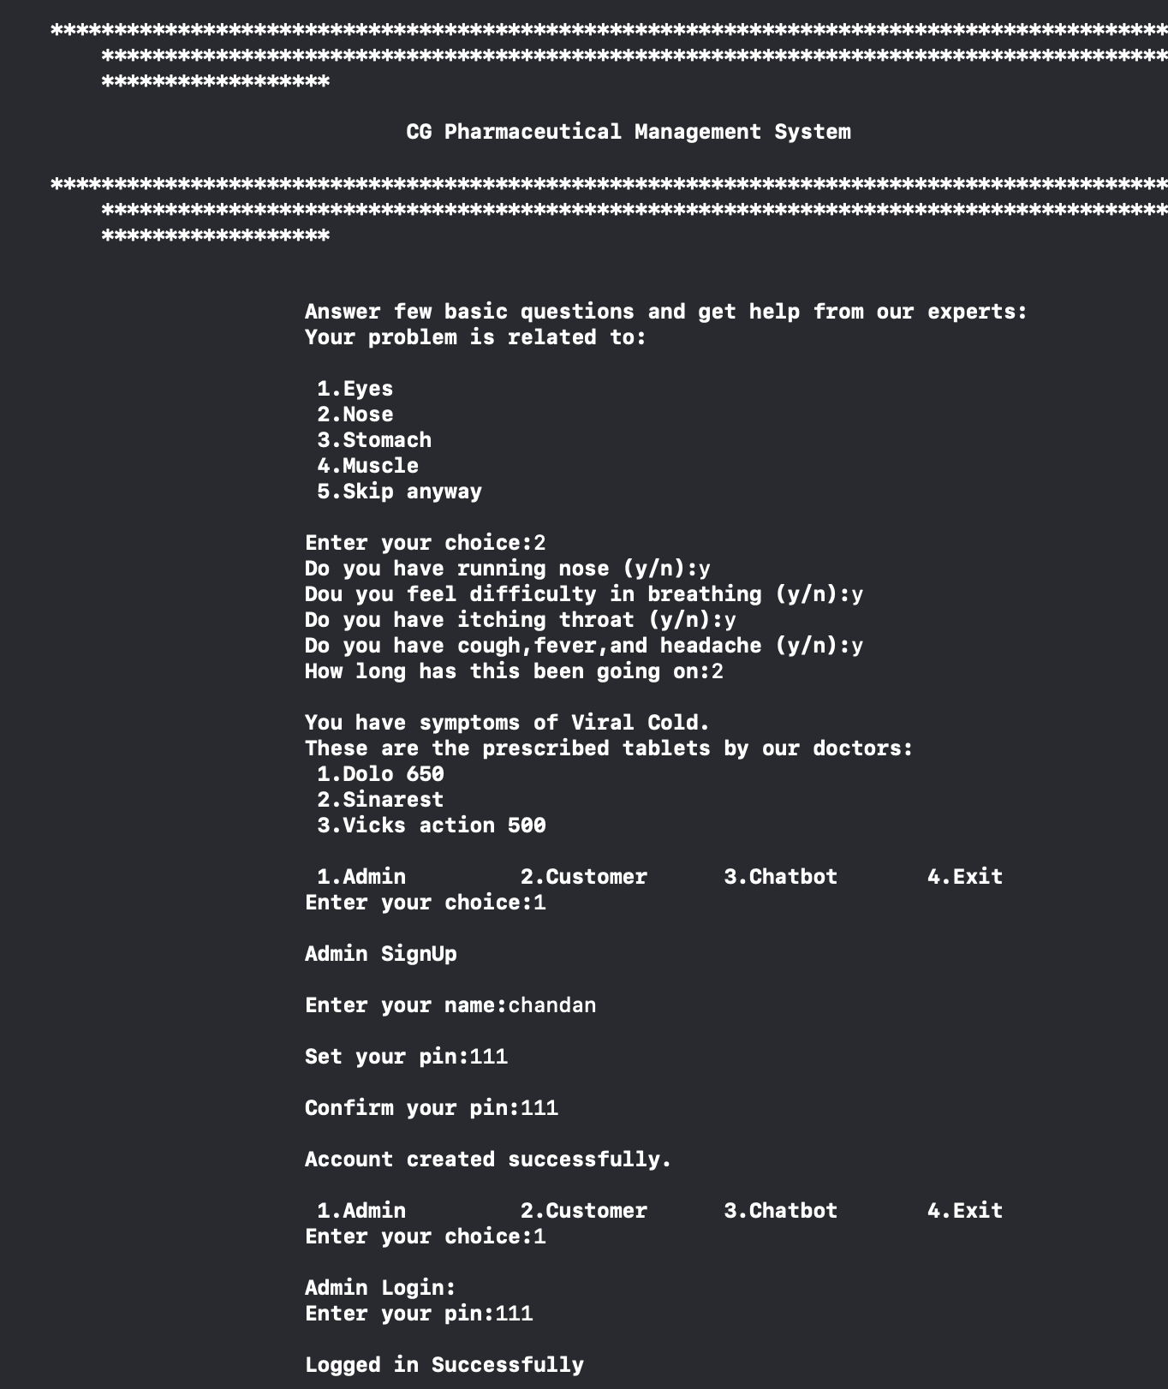
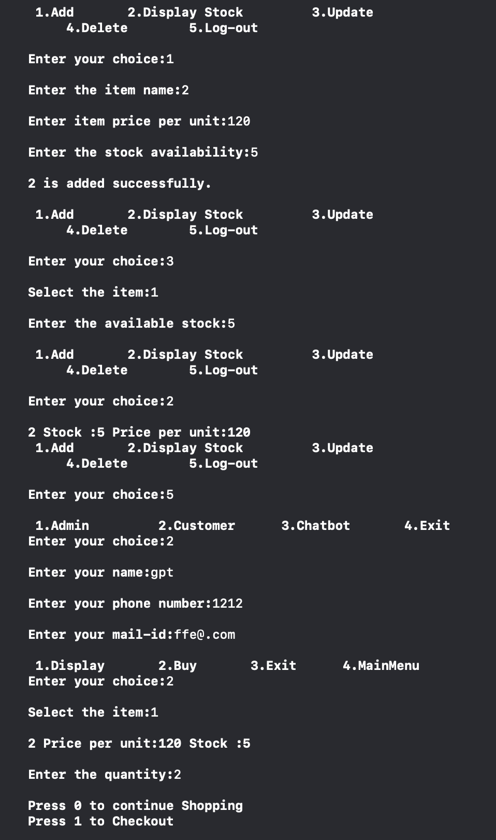
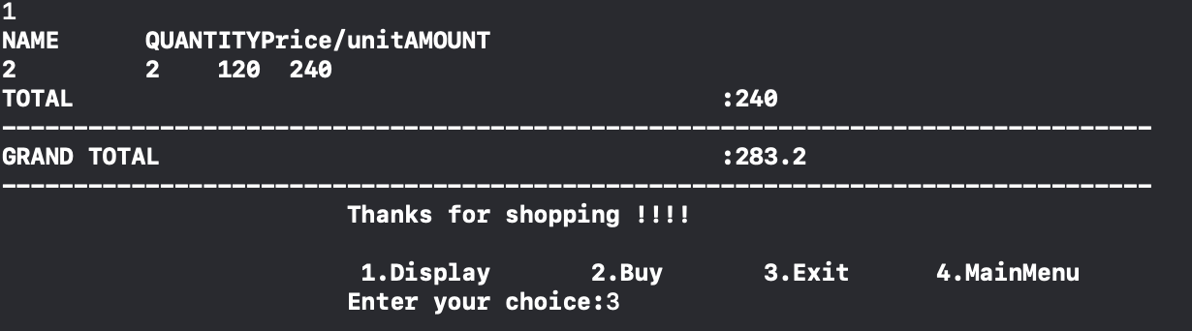
Pharmaceutical Management System
Use of various classes
class person
class item
class admin
class customer
class cart
These classes are used for entering personal detail, no of medicine and type of medicine, admin information for entry of medicine ,customer info,Billing in the end.

Slide 9
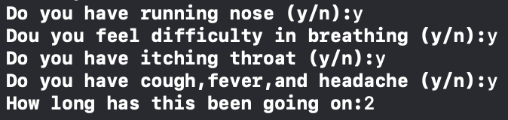
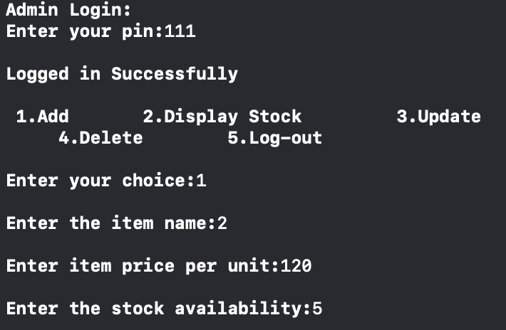
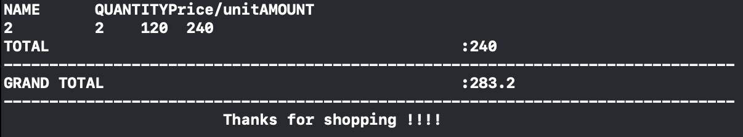
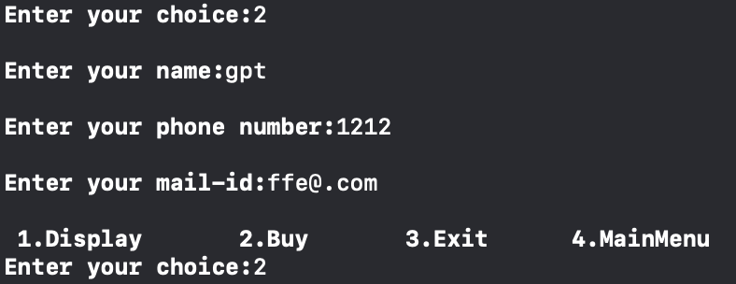
Pharmaceutical Management System
Use of other functions
friend void update(item x[],int j,int y);
friend void adminupdate(item x[],int j,int y);
void customer ::buy(item o[])
void displaybill(cart d[],int m,float bill)
void chatbot()
These function are used in updating stock of medicine,helps admin in deleting and adding stock,display customer bill add item to customer cart, ask various question assigned through chatbot.

Slide 10
Pharmaceutical Management System
Some of the Variables Used
string iname;
string mail,ph;
float bill=0;
int choice,opt,sel,k=0,u,count;

Slide 11
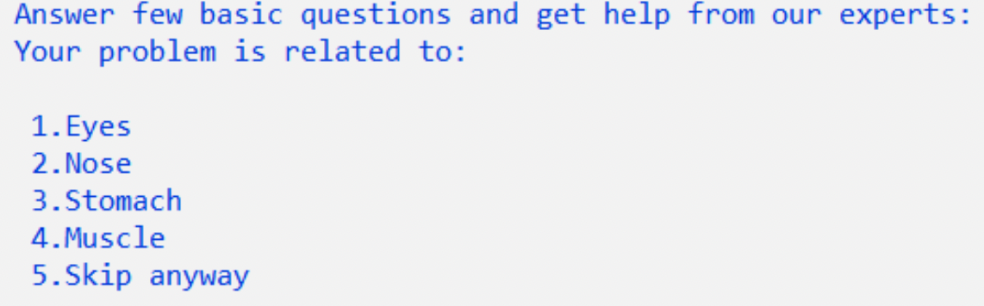
Pharmaceutical Management System
OUTPUT:Welcome screen – ChatBot
Here in welcome screen, we get input prompt to select needed option by the user.

Slide 12
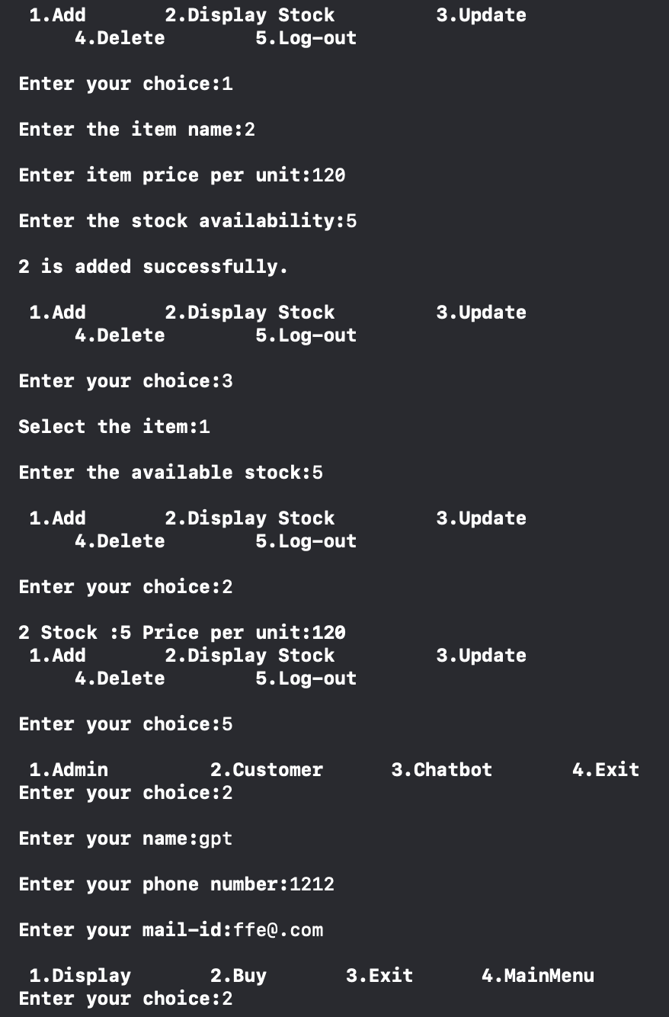
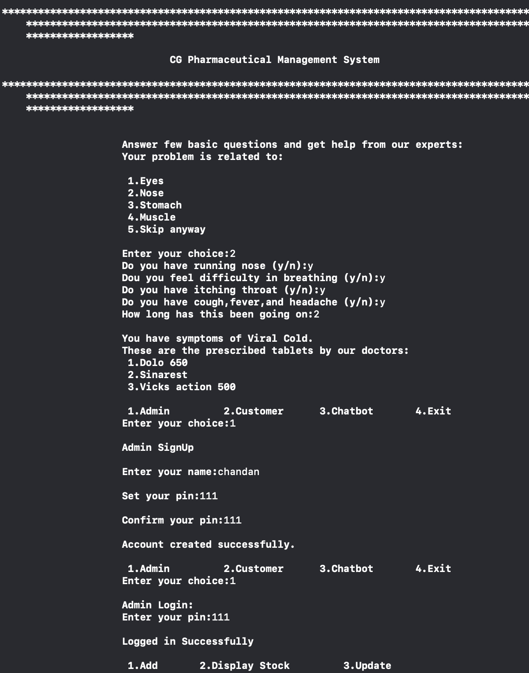
Pharmaceutical Management System
OUTPUT EXAMPLE -

Slide 13
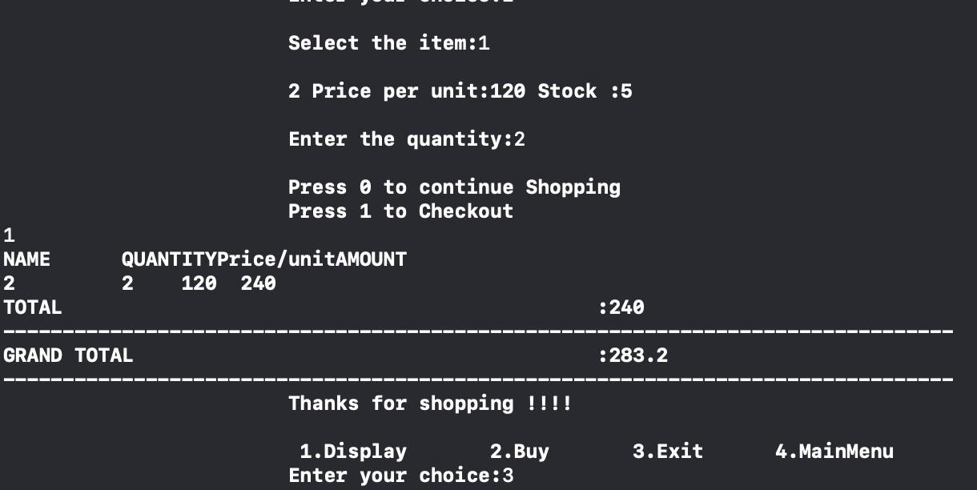
Pharmaceutical Management System
OUTPUT EXAMPLE -

Slide 14
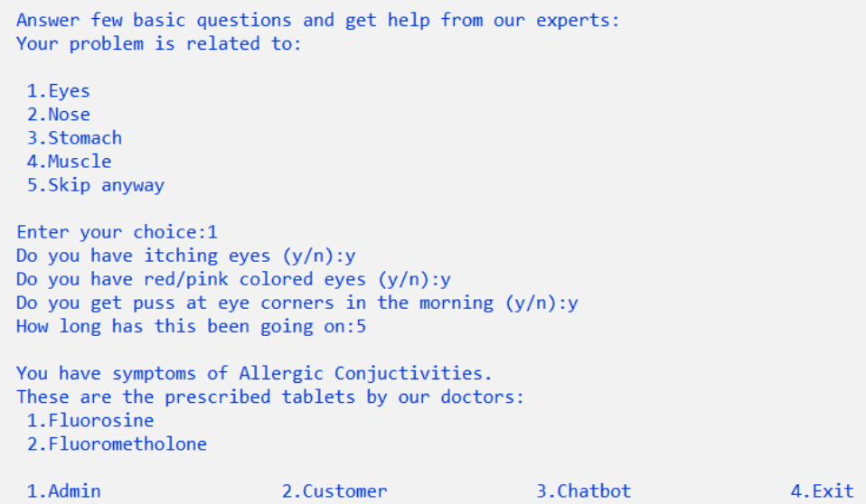
Pharmaceutical Management System
Main menu screen
Here user enters faces the main menu where he can choose
either admin or customer domain after interfacing chatbot and getting info. from medical experts
example-we have inputed option 1 of eyes which then ask user symptoms related to eye problem and recommend the medicine

Slide 15
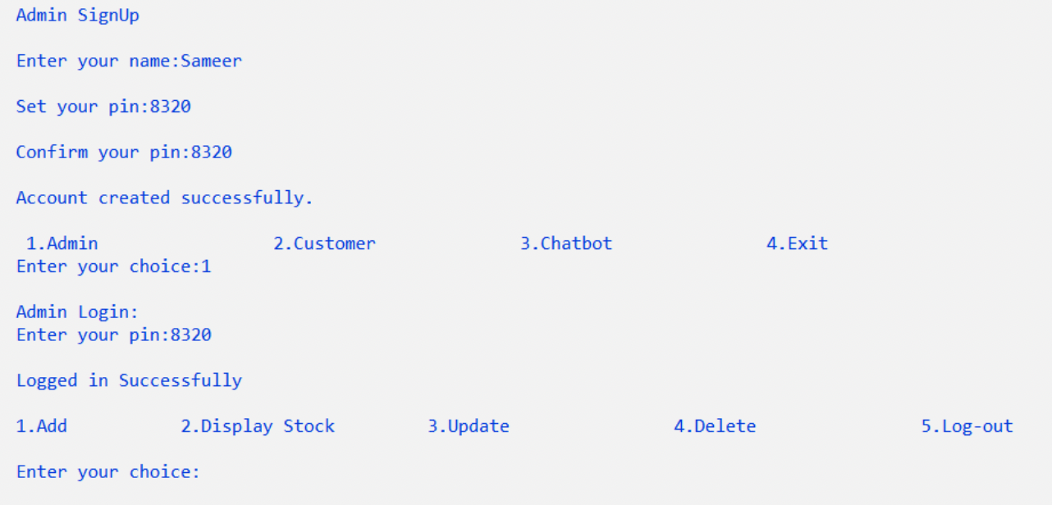
Pharmaceutical Management System
Admin Domain
Here system shows the user after he selects admin domain and creates his/her account by entering valid details and this would be stored in a .txt file named “admin”

Slide 16
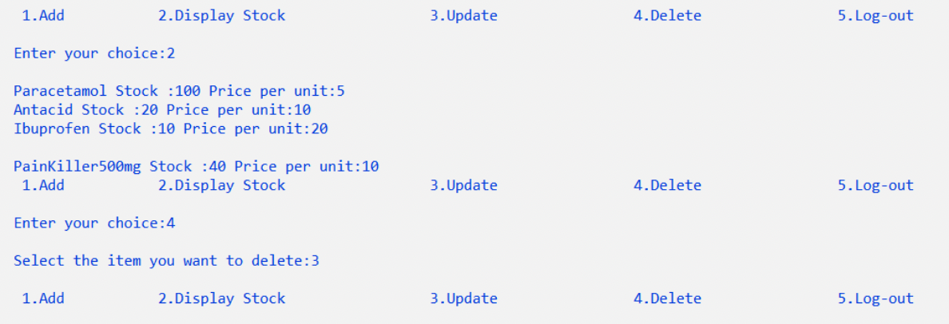
Pharmaceutical Management System
Admin Domain(when Used By admin)
Admin can sign in and add the amount of stock of medicine available and delete the amount of medicine admin wants too after completing he/she can simply log out.

Slide 17
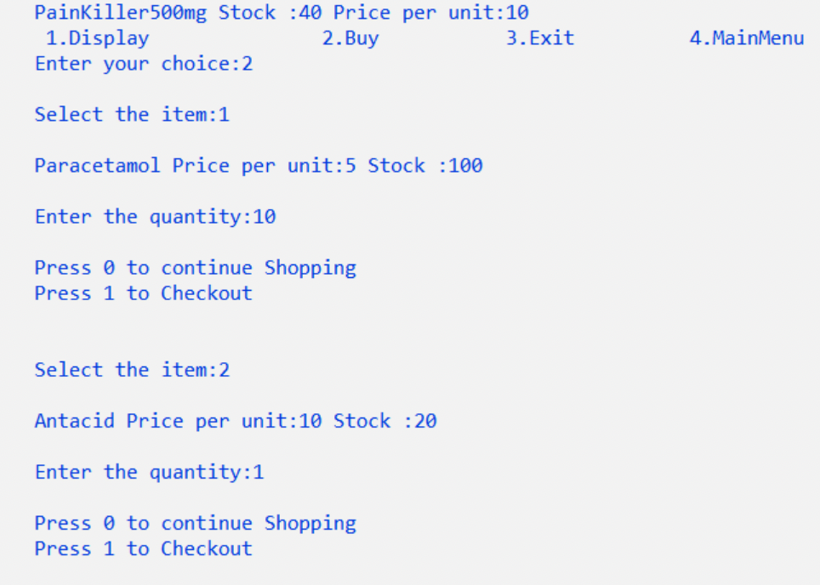
Pharmaceutical Management System
Customer Domain
Here, customer can buy add items to his/her cart depending upon his/her needs and he can manipulate the cart as well. if stock is not available then it will show an error.

Slide 18
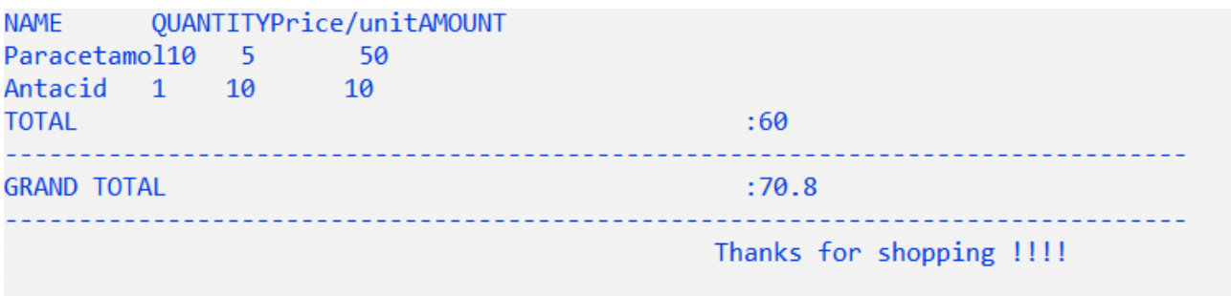
Pharmaceutical Management System
Billing Section
Here, customer can get his bill generated along with 18% GST included on Medicine . This is the final section where bill is generated.

Slide 19
Pharmaceutical Management System
CONCLUSION
CG Pharmaceutical Management System helps in easy and effortless buying of health care products and helps user in reducing the contact with infected individuals and helps in diagnosis of the health issue of the patients with the help of ChatBot and fetch help from the medical experts which is very crucial in these days.

Slide 20
Pharmaceutical Management System
THE END..

